Slide 1





INTELLIGENT REACTIVE ENERGY MANAGEMENT FOR INDUSTRIAL AND POWER GRID EFFICIENCY
398
SIKKANTHAR MYDEEN.R
ELECTRICAL & ELECTRONICS ENGINEERING COLLEGE
P.S.R.ENGINEERING COLLEGE

Slide 2
ABSTRACT
The primary abstract is APFC enhance the power factor of the electrical system.
Improved power factor reduces stress on electrical equipment with maintaining voltage levels and ensuring system stability.
To utilizing power more effectively and reducing wasteful consumption of reactive power.

Slide 3
INTRODUCTION
Intelligent management of reactive power in both industrial and power grid operations to presented by maintaining voltage level, system stability and reliability.
Inefficient management of reactive power, such as increased energy losses, decreased system reliability, and higher operational costs

Slide 4
LITERATURE SURVEY
X. Wang, T. Zhao, and A. Parisio's research on “Frequency regulation and congestion management by virtual storage plants”
K. Qu, X. Zheng, X. Li, C. Lv, and T. Yu's work on “ Realtime power dispatch with wind uncertainty using difference-of-convexity optimization”
V. K. Prajapati and V. Mahajan's study on “Demand response based congestion management of power system with uncertain renewable resources”
A. Agrawal, S. N. Pandey, L. Srivastava, P. Walde, S. Singh, B. Khan, and R. K. Saket's research on “Hybrid deep neural network-based generation in power management ”

Slide 5
PROPOSED METHODOLOGY
Developing a model of the industrial or power grid system within MATLAB/Simulink to major components such as power grid, capacitor load, APFC and other reactive power sources.
Integrate real-time monitoring and data acquisition functionalities with Design intelligent control algorithms manage reactive power flow in the system.
To measure by waveform’s & range’s in V rms, I rms, real power, reactive power & power factor

Slide 6
PROPOSED METHODOLOGY
3 PHASE SUPPLY
INDUCTIVE LOAD
APFC
CAPACITOR BANK
POWER SUPPLY
MICRO CONTROLLER UNIT (ARUINO_UNO)

Slide 7
PROPOSED METHODOLOGY
APFC ALGORITHM
function[cb_1,cb_2,cb_3]=ARDUINO_UNO(PF_VALUE)
if
(PF_VALUE<=0.60)
cb_1=1;cb_2=0; cb_3=0;
elseif
(PF_VALUE<=0.75)
cb_1=0;cb_2=1; cb_3=0;
elseif
(PF_VALUE<=0.85)
cb_1=0;cb_2=0; cb_3=1;
else
cb_1=0; cb_2=0; cb_3=0;
end

Slide 8
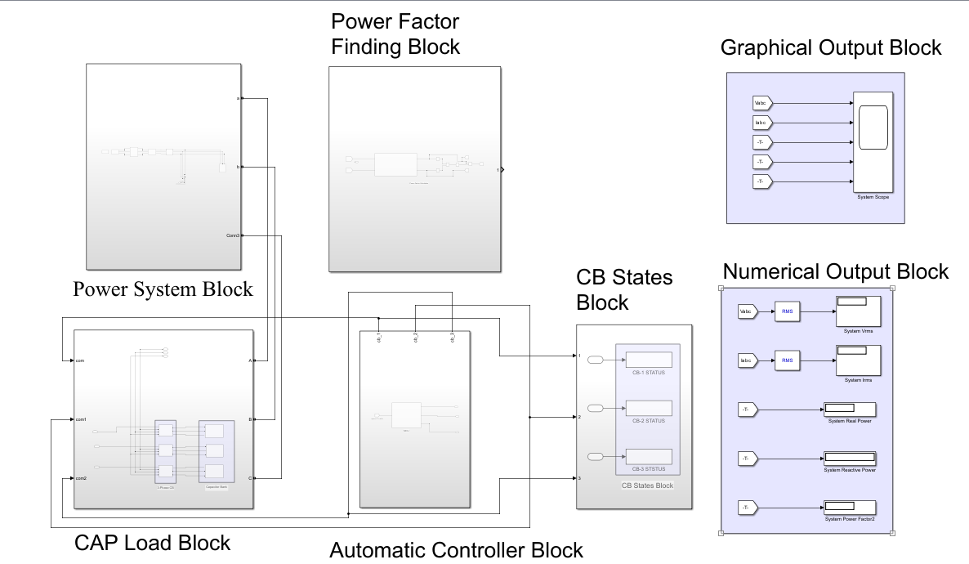
RESULTS AND DISCUSSION

Slide 9
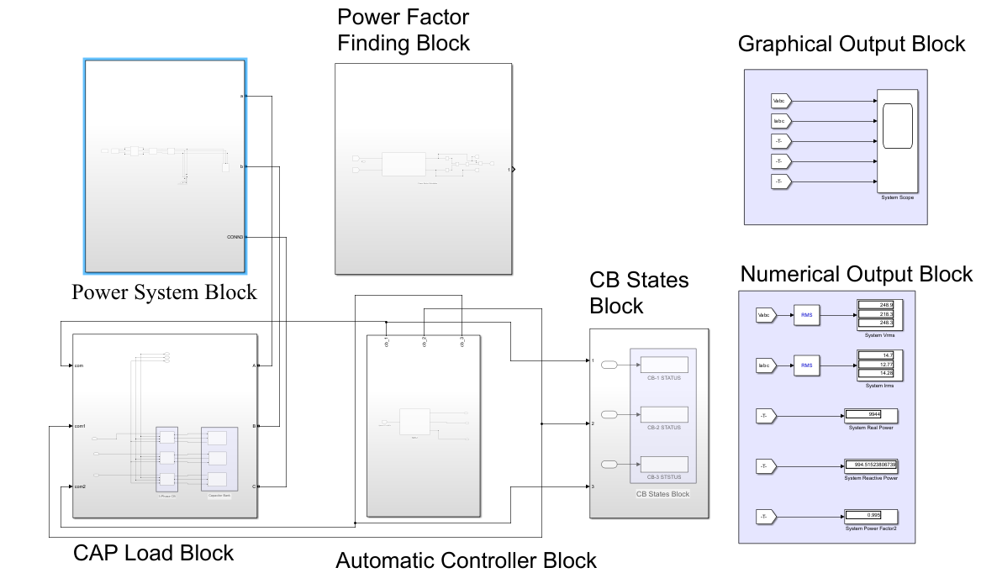
RESULTS AND DISCUSSION

Slide 10
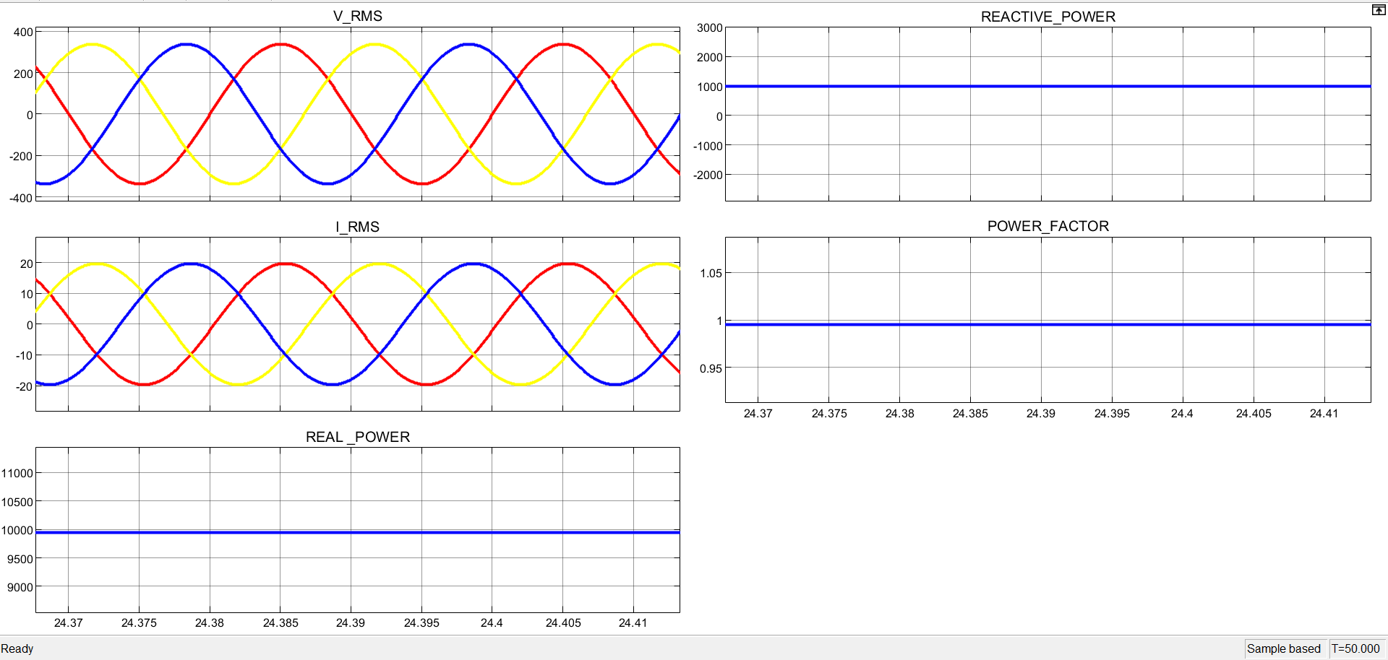
RESULTS AND DISCUSSION

Slide 11
RESULTS AND DISCUSSION
SNO | REAL POWER | REACTIVE POWER | POWER FACTOR | CAPACITOR CB1 CB2 CB3
1 | 9936 | 6955 | 0.81 | 0 | 0 | 1
2 | 29510 | 37407 | 0.61 | 0 | 1 | 0
3 | 39580 | 35612 | 0.74 | 0 | 1 | 0
4 | 39450 | 57698 | 0.56 | 1 | 0 | 0
5 | 39430 | 62588 | 0.53 | 1 | 0 | 0

Slide 12
CONCLUSION
Efficiency enhancement in IREM systems promise to reactive power flow dynamically and peak efficiency with minimizing losses in power systems.
Industrial benefits of IREM within industrial facilities reduces energy consumption, equipment lifespan and productivity.
Power grid benefits in IREM with improving voltage stability, reduced transmission losses, & energy efficiency with reliability.

Slide 13
REFERENCES
X. Wang, T. Zhao, and A. Parisio, ‘‘Frequency regulation and congestion management by virtual storage plants,’’ Sustain. Energy, Grids Newt., Vol. 29, Mar. 2022, Art. no. 100586.
K. Qu, X. Zheng, X. Li, C. Lv, and T. Yu, ‘‘Stochastic robust Realtime power dispatch with wind uncertainty using difference-of-convexity optimization,’’ IEEE Trans. Power Syst., vol. 37, no. 6, pp. 4497–4511,Nov. 2022.
V. K. Prajapati and V. Mahajan, ‘‘Demand response based congestion management of power system with uncertain renewable resources,’’ Int.J. Ambient Energy, vol. 43, no. 1, pp. 103–116, Dec. 2022.
A. Agrawal, S. N. Pandey, L. Srivastava, P. Walde, S. Singh, B. Khan, and R. K. Saket, ‘‘Hybrid deep neural network-based generation rescheduling for congestion mitigation in spot power market,’’ IEEE Access, vol. 10,pp. 29267–29276, 2022

